Slide 1
COMP 2710 Software Construction
Vectors
Dr. Xiao Qin
Auburn University
http://www.eng.auburn.edu/~xqin
xqin@auburn.edu
Spring, 2012

Slide 2
Vectors
Vector Introduction
  Recall: arrays are fixed size
  Vectors: "arrays that grow and shrink"
    During program execution
  Formed from Standard Template Library
  (STL)
    Using template class
7-<number>
Copyright © 2010 Pearson Addison-Wesley. All rights reserved.

Slide 3
Vector Basics
Similar to array:
  Has base type
  Stores collection of base type values
Declared differently:
  Syntax: vector<Base_Type>
    Indicates template class
    Any type can be "plugged in" to Base_Type
    Produces "new" class for vectors with that type
  Example declaration:
  vector<int> v;
7-<number>
Copyright © 2010 Pearson Addison-Wesley. All rights reserved.

Slide 4
Vector Use
vector<int> v;
  "v is vector of type int"
  Calls class default constructor
    Empty vector object created
Indexed like arrays for access
But to add elements:
  Must call member function push_back
Member function size()
  Returns current number of elements
7-<number>
Copyright © 2010 Pearson Addison-Wesley. All rights reserved.

Slide 5
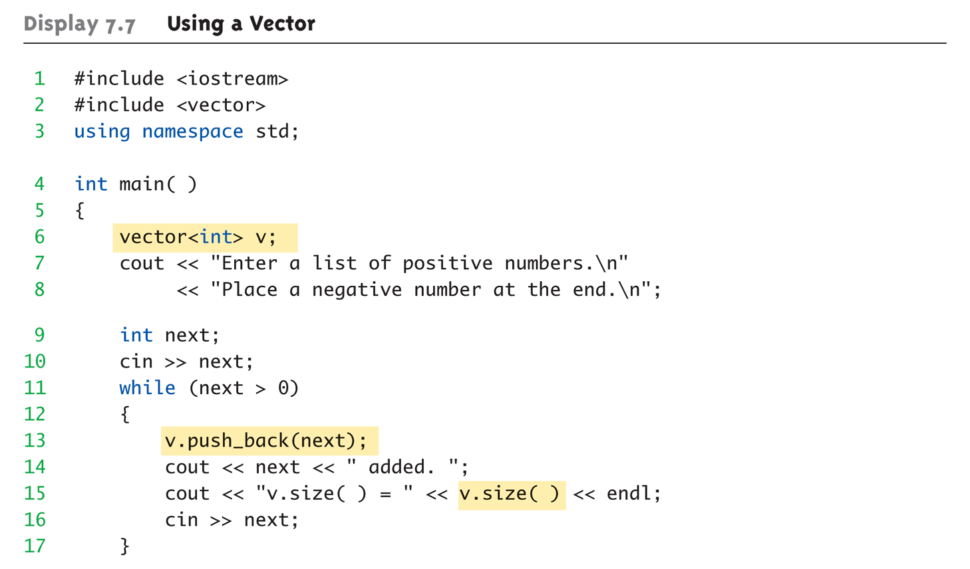
Vector Example:
Display 7.7 Using a Vector (1 of 2)
Copyright © 2010 Pearson Addison-Wesley. All rights reserved.
7-<number>

Slide 6
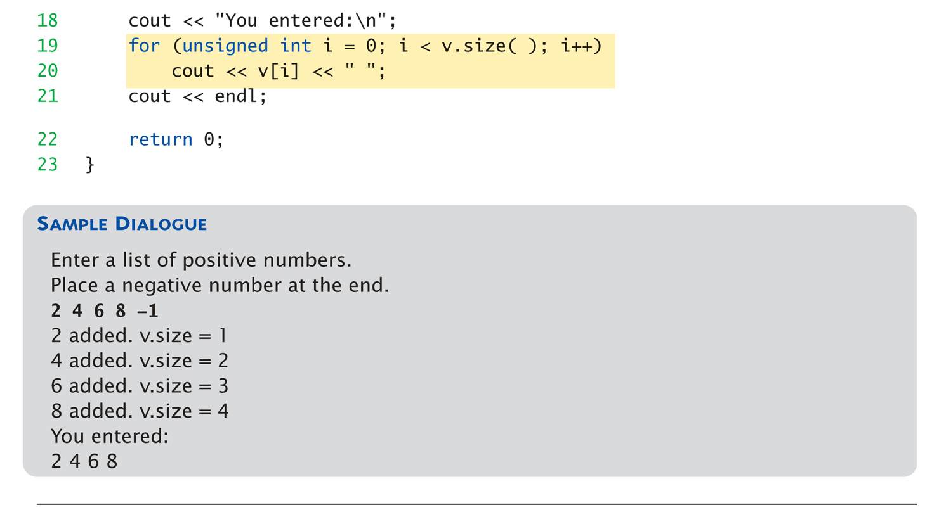
Vector Example:
Display 7.7 Using a Vector (2 of 2)
Copyright © 2010 Pearson Addison-Wesley. All rights reserved.
7-<number>

Slide 7
Vector Efficiency
Member function capacity()
  Returns memory currently allocated
  Not same as size()
  Capacity typically > size
    Automatically increased as needed
If efficiency critical:
  Can set behaviors manually
    v.reserve(32); //sets capacity to 32
    v.reserve(v.size()+10); //sets capacity to 10 more
    than size
7-<number>
Copyright © 2010 Pearson Addison-Wesley. All rights reserved.

Slide 8
Exercise
Implement the first two member functions
class Menu {
public:
void displayOptions( );
void addAnOption(string newMessage);
bool selectOption(int& option); //must be updated to handle errors.
private:
vector<string> optionMessage;
};
7-<number>

Slide 9
How to design a good menu class?
class Menu {
public:
void displayOptions( );
void addAnOption(string newMessage);
bool selectOption(int& option); //must be updated to handle errors.
private:
vector<string> optionMessage;
};
Notes:
Associations connect instances of two or more classes together for some duration (as opposed to a dependency relationship, which represents a temporary association between two instances).
Dependency relationships will be discussed in the Class Design module.
Do not use relationship/role names if they add no value/information to the model. Remember, readability and understandability of the model are key -- only add information that adds value, not clutter to the diagrams.

Slide 10
Summary
Vector classes
  Like: "arrays that grow and shrink"
7-<number>
Copyright © 2010 Pearson Addison-Wesley. All rights reserved.

